Slide 1
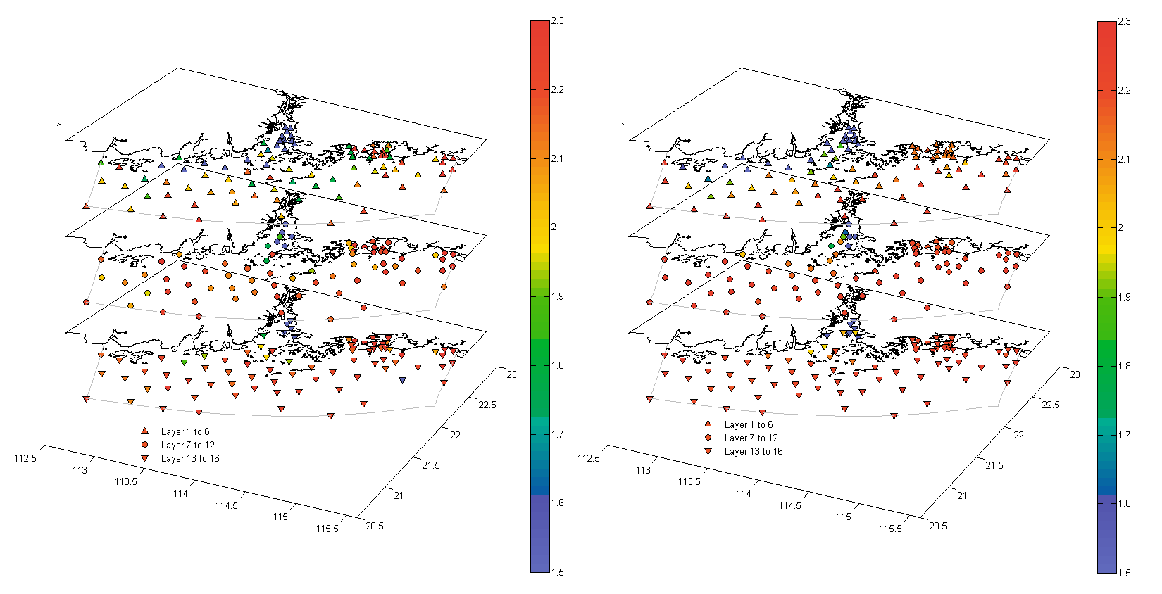
Observed Total alkalinity
Period: 15th July 2006 to 24th August 2006
Simulated Total alkalinity
Period: 15th July 2006 to 24th August 2006
Surface Layer
Surface Layer
Middle Layer
Middle Layer
Surface Layer
Middle Layer
Bottom Layer
Bottom Layer
Surface Layer
Middle Layer
Bottom Layer
Bottom Layer
Unit: mmol L⁻¹
Unit: mmol L⁻¹
Notes:
Figure 4. Comparisons of the simulated (right panels) and the observed (left panels) TA during 15th July 2006 to 24th August.

Slide 2
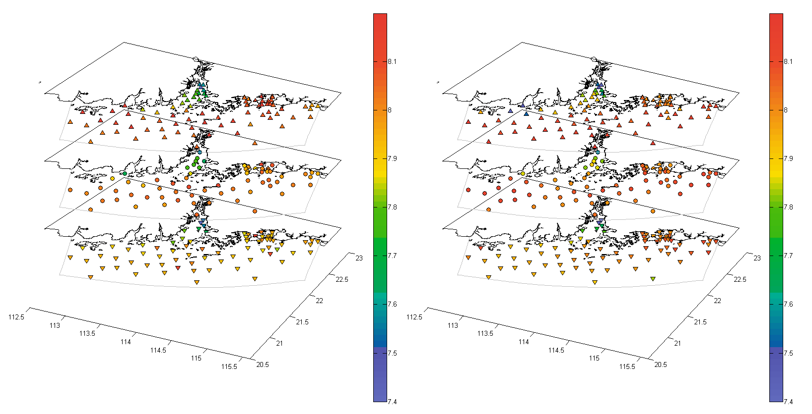

Observed pH
Period: 15th July 2006 to 24th August 2006
Simulated pH
Period: 15th July 2006 to 24th August 2006
Surface Layer
Surface Layer
Middle Layer
Middle Layer
Surface Layer
Middle Layer
Bottom Layer
Bottom Layer
Surface Layer
Middle Layer
Bottom Layer
Bottom Layer
Notes:
Figure 4. Comparisons of the simulated (right panels) and the observed (left panels) pH during 15th July 2006 to 24th August.

